Slide 1
Current Articles Presentation
Team 2
Irfan Olia
Siddharth Gulati
Parth Maheshwari
Harshit Joshi

Slide 2
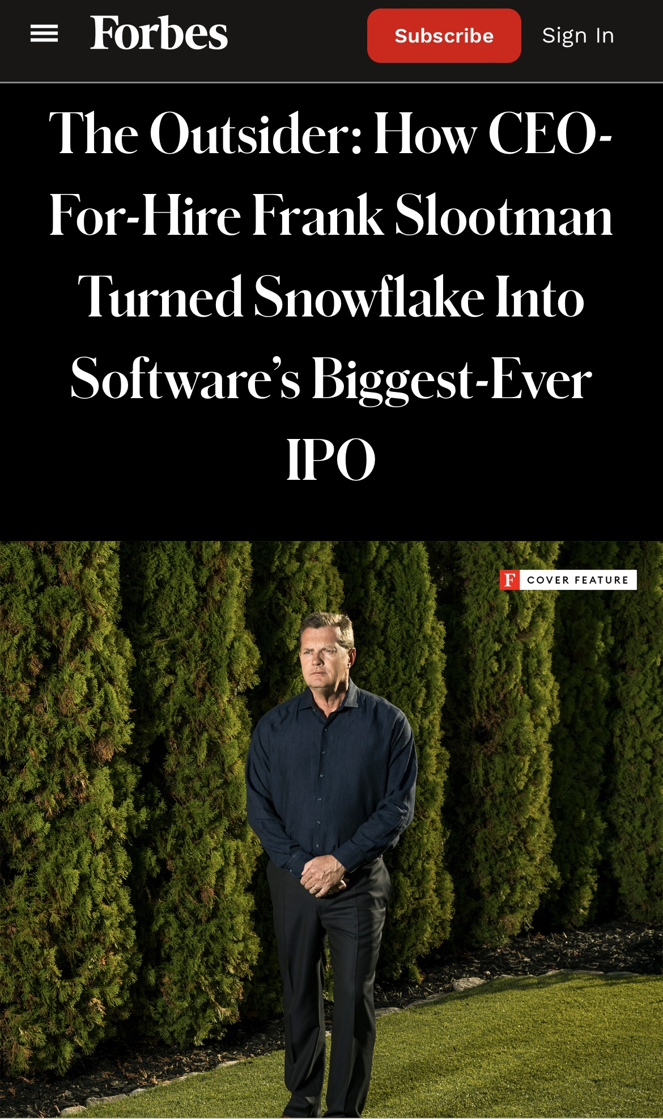
The Outsider: How CEO-For-Hire Frank Slootman Turned Snowflake Into Software’s Biggest-Ever IPO
Source: Forbes

Slide 3
Key Points
Quick cloud data warehousing solution offering that acted like a one giant supercomputer
Located and organized large amounts of data, like consumer information, product sales and employee overhead etc.
Customers could make sense of data by quickly and cheaply making useful business decision e.g. optimizing labor costs
Competitor – Amazon Webservice (subscription model), Redshift, Google’s Big Query and Microsoft’s Azure Synapse products
Offered pay as you go alternative vs subscription model
Challenges - required a large and continuous amount of R&D spending.
Frank Stootman was hired as a CEO by Snowflake

Slide 4
Strategic Decisions taken by Slootman as CEO
Reorganized the business to focus on converting few large clients vs many small ones
Large customers were presented with Cost saving opportunities
Brought in his top lieutenants from Service Now to execute his strategy
Promoted Performance Based Business
Valued executives with loyalty and enthusiasm to the product
Focused spending on “drive train”—product, engineering, sales and legal
Made it Wall Street Ready for IPO launch
Created enthusiasm in the product that inflated stock valuation.

Slide 5
Future Strategy
Move towards data hub concept
Business can securely (and temporarily) share information with each other, develop apps and feed their data into artificial intelligence tools.
Lock in Large enterprise into snowflake solution for long term basis
Manage stock price bubble and retain employees with IPO stock benefits

Slide 6
SWOT Analysis
Strengths - Advanced technology - Strong CEO and management team with proven track record -Clear Objectives | Weaknesses High Webservices cost based solution Dependence on Capital raised from IPO and inflated stock valuation. Decrease in market CAP may reduce its ability to fund its future R&D
Opportunities - Growing industry due to global supply chain challenges - Extreme inclination of businesses to improve data retention and data mining through AI based data management tools | Threats - Large competitors like Amazon webservices with huge capital investment available at their disposal

Slide 7
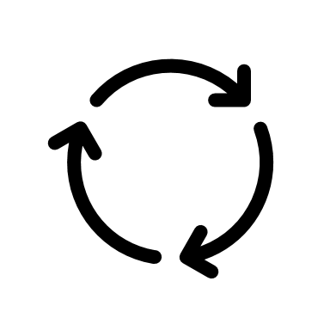
Porter's Five Forces
Competitive Rivalries (High)
High Number of competitors
Unique feature product
High Industry growth
Threat of New Entry
Threat of New Entry is low
Barriers to entry - Requires high economies of scale - High Capital Investment
Bargaining Power of Customers (low)
Price sensitivity is high
Switching Cost is high
Backward integration is low
Bargaining Power of Suppliers (high)
Theat of forward integration is high from partners like Amazon
Competitive Rivalries
Threat of Substitutes
Threat of Substitutes (low)
Existing solutions are slow and do not provide analytics or automation or data sharing
As per Porter analysis it’s a profitable industry to be in as 3 out of 5 forces are in favor

Slide 8
Points to Consider
How does this relate to the changing role of the CIO?
The CIO must be adaptable and possess quick and adaptive decision making skills like Slootman
CIO must and the management team must of have prior experience in this capacity
Does more spending increase competitive advantage?
It has the potential to, if implemented properly however CEO and CIOs need to be conscious that shareholders expect them to make profits
How can companies try to ensure their investments will be successful?
IT strategy should be connected with the business model that would benefit the businesses to gain more market share in future through competitive advantage

Slide 9
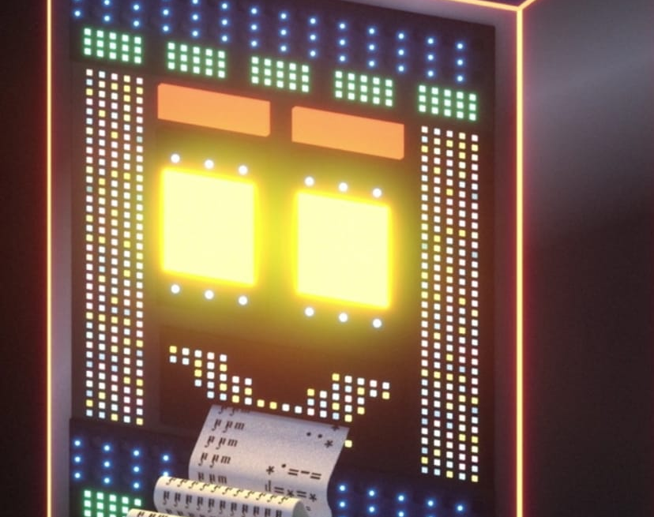
Whatever Happened to IBM’s Watson By Steve Lohr
The New York Times

Slide 10
A Short Overview
Watson was launched in 2010 by IBM showcasing the power of A.I. by trouncing Ken Jennings as the best human player “Jeopardy” ever.
IBM was exploring Watson’s potential in health care, law, finance and academia despite the warnings given by David Ferrucci.
Watson’s objective was to do pioneering good for the society which was considered laudable, and it was being focused for narrow credibility demonstrations.
Today Watson is a perfect example of the pitfalls of technological hype and hubris around A.I. as it is being used to for a much simpler task rather than a very complicated one.

Slide 11

Product Lifecycle Chart
Maturity
Growth
Decline
Profit
Introduction
Decline
Launch
Early Promises
Really, Really Hard
Failing to Deliver
Fall
Time
Watson was launched in 2010 creating huge hype for A.I.
Watson faced the contrast in ambition which was created during the launch phase
IBM over promised the deliverables during the early launch stage
The development of such a smart A.I. made IBM realize the costs as well as the mistake of over promising
People started considering Watson as publicity stunt

Slide 12

Journey of Watson
IBM took over the market rapidly by PC sales in 1981. In 1990s, IBM helped its corporate customers to align themselves with the technology and finally there came the time of A.I.
Finally, a room-sized supercomputer was developed inside IBM consuming 85,000 watts of power with thousands of processors running millions of lines of codes named Watson.
It was simple tool which was suitable for automated question answering but IBM took chance by playing a ‘moon shot’ with it.
IBM tried to use Watson in health care sector considering that it would be the start of a modern era but instead they lost millions due to over ambitiousness .
The above approach was not a complete failure. IBM was able to identify one potential use of Watson that was to identify hidden patterns and combinations which might have been overlooked earlier.
Today Watson is being used as a tool to build A.I. based applications and for automating the standard processes.

Slide 13
Key Success Factors
For having a business which is running on A.I . there are few factors which acts as the keys for success
Customer Understanding
After-Sales Service
Continuous Improvement
Communication

Slide 14
SWOT Analysis
Strengths IBM Watson has an experience of about 140 years, allowing company to much better carry out, in various circumstances Natural Language Integration Processing big data | Weaknesses Slow Integration Steep learning curve High site maintenance
Opportunities Demand for IBM Watson data insights to increase at a fast pace Demand for IBM Watson text-to-speech services surging IBM Watson services for prevention of cyber-attacks to gain traction | Threats A lot of competitors in the market with same type of product Unethical use of sophisticated AI Cyber-attacks and data breaches
Notes:
The amount of data a business collects and process is growing exponentially. This means that you can’t take the same old approach to processing data.
This is where machine learning can help. By processing massive amounts of data from disparate sources quickly, a system like Watson can provide quicker trends and analysis than your traditional spreadsheet system ever could. If you can get a machine learning engine tuned correctly, it can show you things you need to know a lot more quickly than is possible in the status quo.
This is what hospitals and medical researchers are looking for from Watson. By giving doctors access to research that is on point more quickly, an AI system can provide better options for diagnosis and treatment.

Slide 15
Article Summary
Watson’s performance on standard natural language tasks is equal or better than top 3 tech giants – Google, Microsoft, Amazon
The business side of Watson is showing good signs
Watson serves as an AI application building platform as opposed to just an AI machine
Watson has 40,000 customers in 20 different industries
Watson may not be the hottest thing on the market but is a solid business for IBM

Slide 16
Thank you

